Slide 1





MARKETFLOW - FROM WEB SCRAPING TO ANALYTICS INSIGHTS IN GROCERY
Haris Nikolakopoulos
BSc Mathematics
Giorgos Zafeiriou
BSc Computer Science

Slide 2


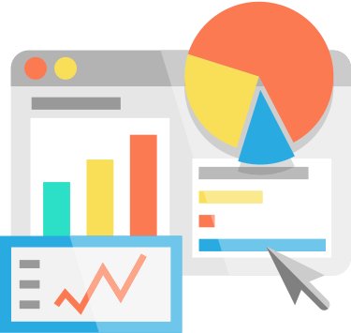

MARKETFLOW - FROM WEB SCRAPING TO ANALYTICS INSIGHTS IN GROCERY
an end-to-end project for gathering data and visualizing trends in everyday products

Slide 3

Project overview
Goals
Challenges
Technologies used
Possible uses
Automate the data extraction process
Continuously acquire daily updates of data due to the dynamic nature of the market
Involve many different vendors
Overcoming counter-scraping obstacles
Unifying the categorization that different stores use
Addressing the complexity of diverse product data, including varied price fields and specifications
Python for coding
Airflow for orchestration
Microsoft Azure for cloud virtualization
Docker for containerization
PostgreSQL for database needs
Business use: to get insights about competitor profile
Customer use: to get a comprehensive market research tool

Slide 4


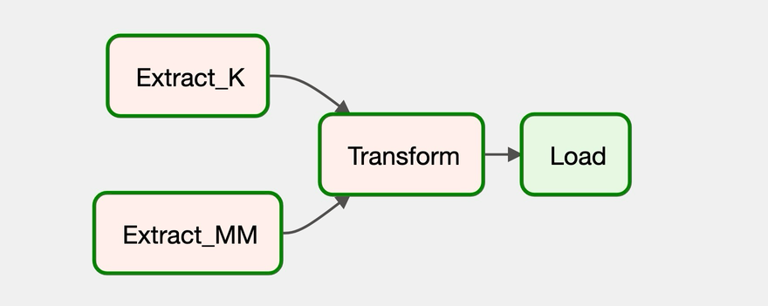









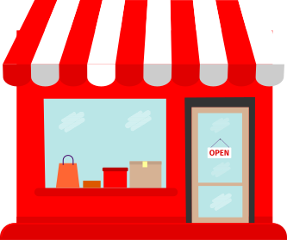
Workflow
Extract
Transform
Load

Slide 5
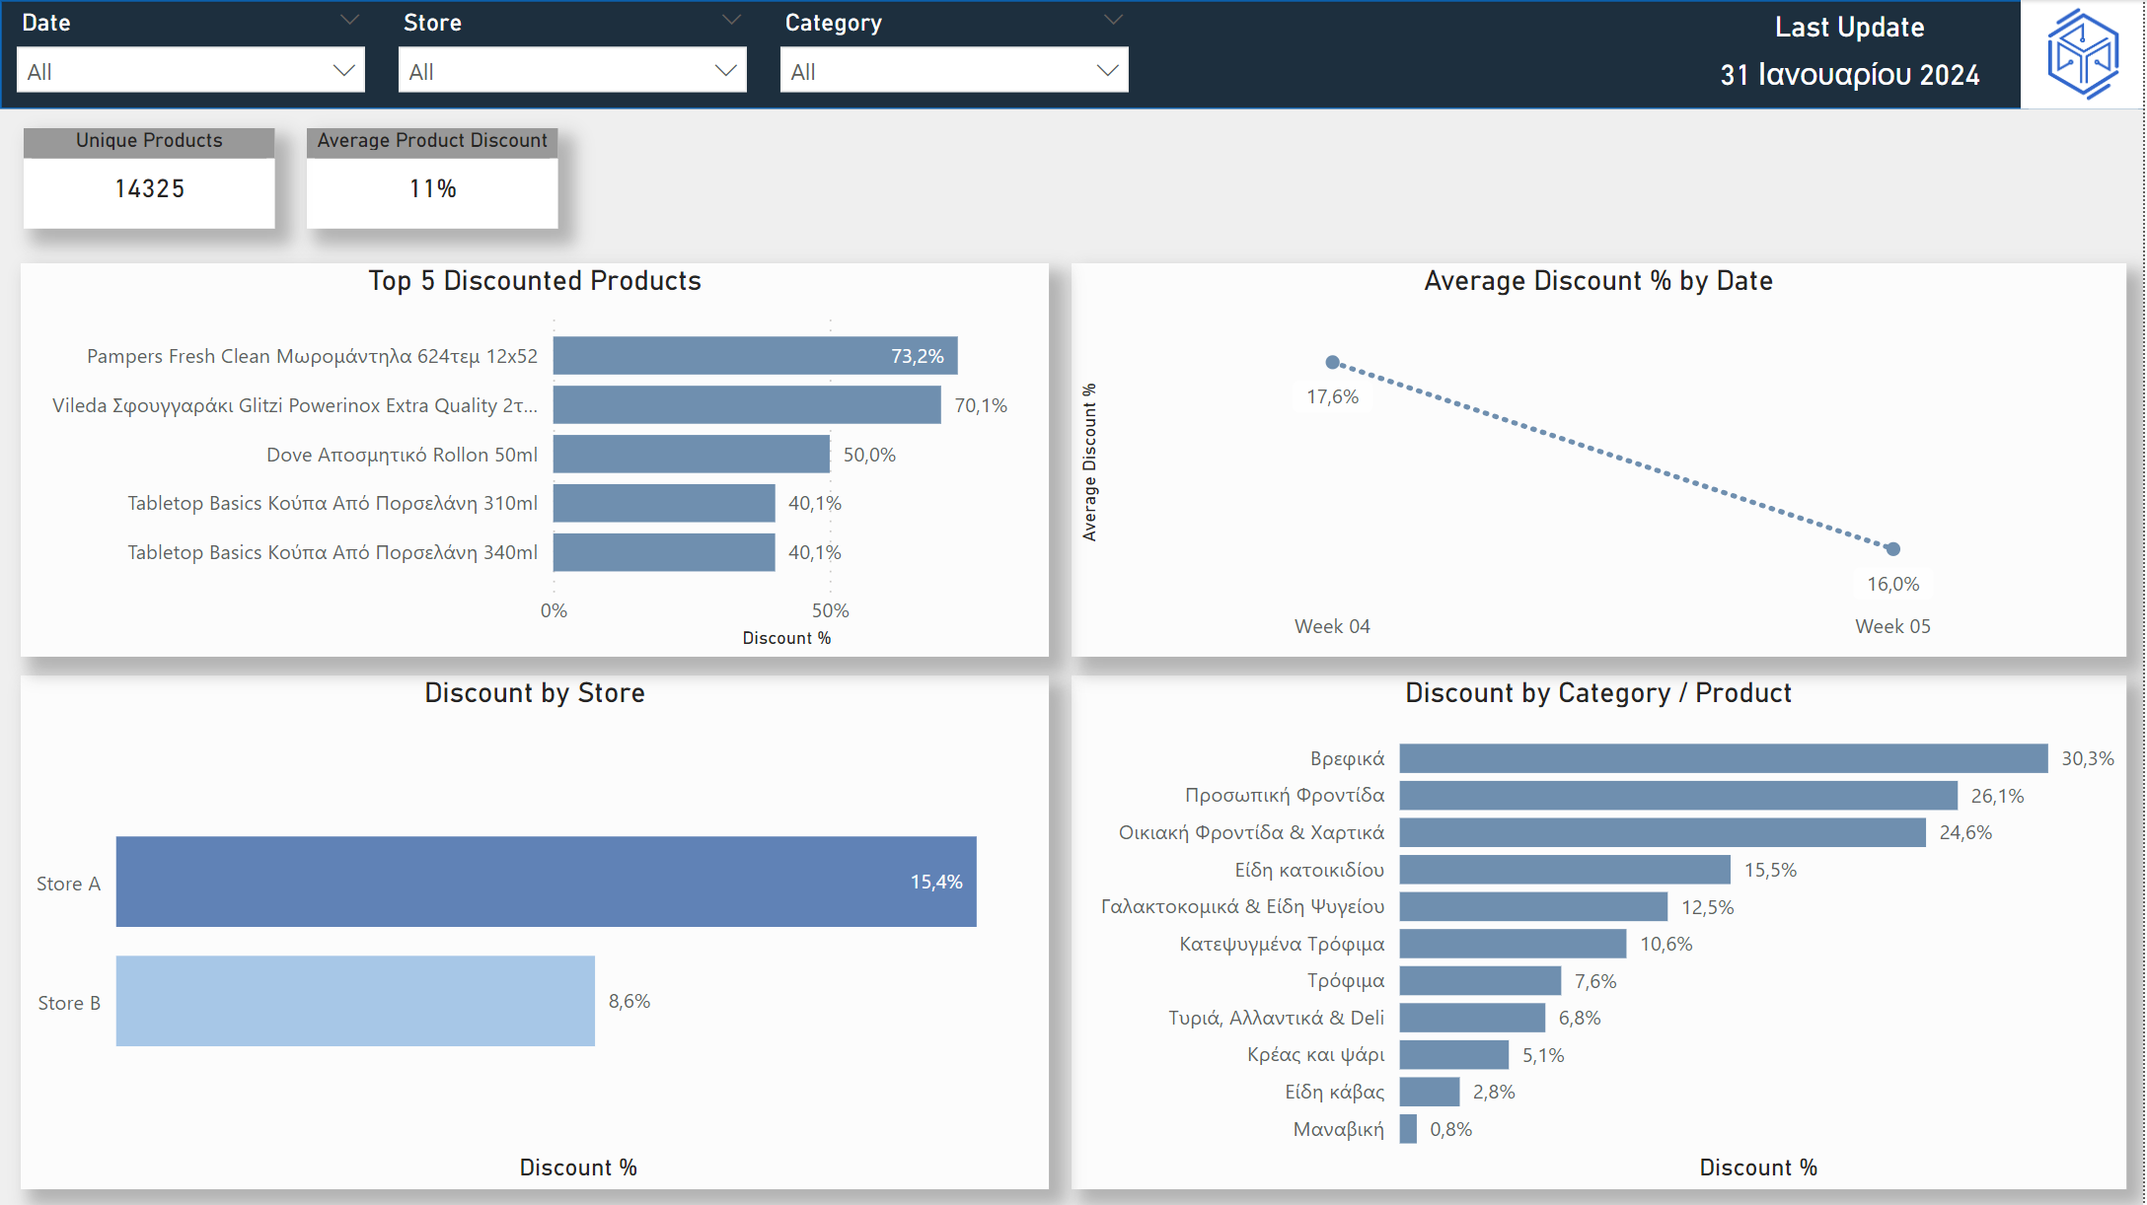

Slide 6
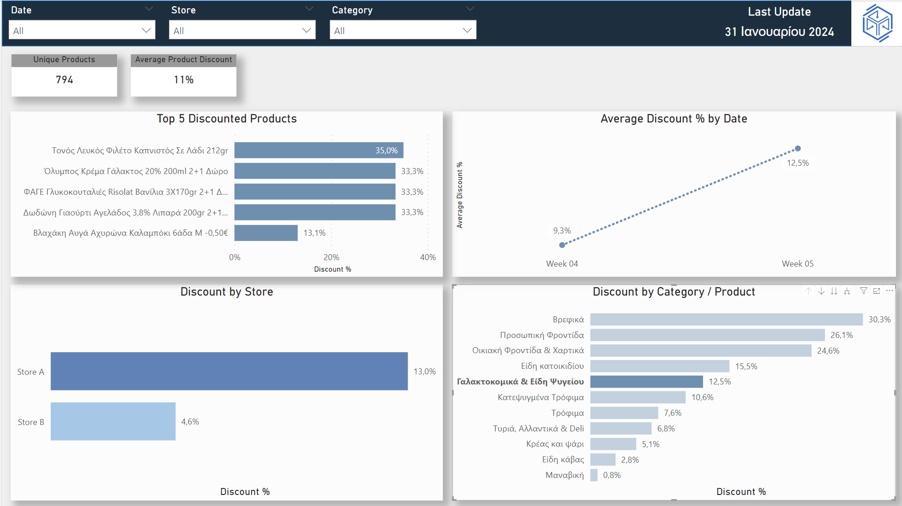

Slide 7
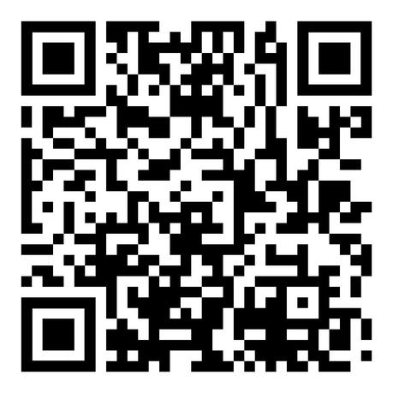
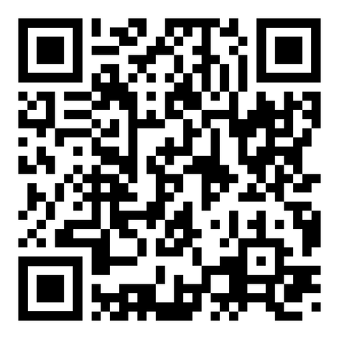
﻿THANK YOU!
any questions?
linkedin.com/in/charalampos-nikolakopoulos/
linkedin.com/in/giorgos-zafeiriou/

